Slide 1
Fractal Jerusalem Cross-Based FSS for X-Band Applications
By:
Koustabh Ram Kandula (21BEC0617)
Anurag Sonar (21BEC0496)
Under Guidance of: Prof. Rajesh N (16153)

Slide 2
Contents
Introduction
Literature Review
Problem Formulation
Relevance
Proposed System
Description
Software Tools
Result Analysis
Conclusion
Individual Contribution
Impact on Society and Environment
Project Outcome
References

Slide 3
Introduction
Definition: FSS are periodic structures that filter electromagnetic waves by allowing, blocking, or reflecting specific frequencies.
Structure: Made of conductive or dielectric elements (e.g., patches, slots, dipoles) arranged in a periodic pattern.
Function in Antennas: Improve bandwidth and radiation control. Reduce interference and enhance signal quality. Act as spatial filters, reflectors, or radomes.
Applications: Satellite communication and radar systems. Wireless networks and reconfigurable antennas. Electromagnetic shielding and stealth technology.
Advancement: Enables compact, high-performance antennas for modern communication and sensing systems.

Slide 4
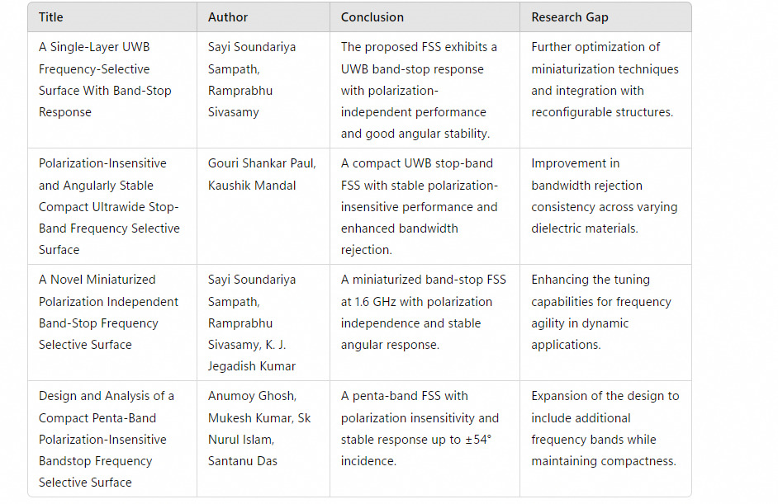
Literature Review

Slide 5
Problem Formulation
Limitations of Standard Shapes: The basic Jerusalem cross was found inadequate in achieving broad stop-bands and deep notches, showing only narrow-band behavior centered around 11 GHz.
Need for Enhanced Resonance Paths: Traditional geometries lacked complexity, limiting their interaction with electromagnetic waves and reducing effectiveness for multi-band applications.
Fractal Geometry as a Solution: The fractal Jerusalem cross was chosen to introduce recursive, self-similar structures, increasing the number of resonant paths and improving frequency selectivity.
Shape’s Role in Angular & Polarization Stability: The symmetrical, fractal layout of the chosen shape inherently supports TE/TM stability and high angular tolerance, addressing performance gaps in earlier designs.
Compactness without Compromise: The shape allows for a single-layer, planar structure that delivers wide-band performance while remaining manufacturable and scalable — ideal for stealth and EMI shielding.

Slide 6

Relevance
The design and application of X-band Frequency Selective Surfaces (FSS) align with several United Nations Sustainable Development Goals (SDGs) by enhancing communication systems, radar technologies, and electromagnetic shielding.
X-band FSS is crucial in security and defense applications, enhancing radar stealth, surveillance, and border security systems.
Used in anti-jamming technologies to secure military and civilian communication networks.

Slide 7
Proposed System
Fractal Jerusalem Cross Geometry: Utilizes a self-similar, multi-scale structure to increase electrical length and support multi-band resonance with enhanced frequency selectivity.
Symmetrical Layout: Ensures polarization insensitivity and angular stability for both TE and TM waves, effective up to 75° incidence.
Design Evolution: Transitioned from a basic Jerusalem cross to a fractal configuration, significantly broadening stopband width and improving notch depth.
Double-Sided Implementation: Further boosts performance by enhancing wave interaction and achieving deeper S21 transmission nulls across a wide frequency band.
Compact and Scalable: Maintains a single-layer structure with fabrication simplicity, while offering potential for integration into advanced, low-profile wireless systems.

Slide 8
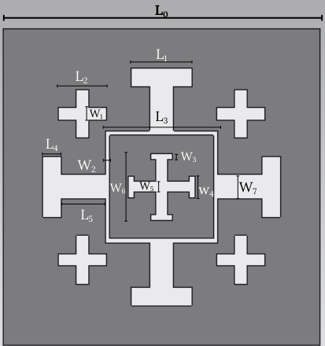
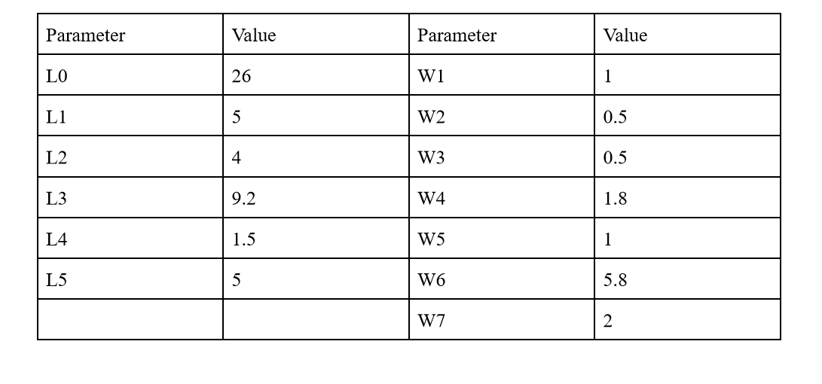
Proposed System (Contd.)

Slide 9

Software Tools
Software used: CST Studio Suite
CST Studio Suite is a leading software for 3D electromagnetic simulation, ideal for designing and analyzing Frequency Selective Surfaces (FSS). It provides accurate modeling of electromagnetic wave interactions with FSS structures.
The software offers specialized solvers, such as frequency domain and time domain solvers, which are essential for evaluating the performance of FSS across different frequencies and incident angles.

Slide 10
Description
Core Structure: Central Jerusalem cross with extended arms serves as the primary resonator for electromagnetic filtering.
Embedded Cross: A smaller cross is nested at the center of the main structure, introducing fractal properties and enabling multi-band resonance.
Peripheral Mini Crosses: Four small crosses are symmetrically placed near each corner of the unit cell, reinforcing the fractal geometry and adding higher-order resonant paths.
Role of Mini Crosses: These peripheral elements enhance electromagnetic interaction, deepen notches in transmission (S21), and broaden the stopband in reflection (S11), especially critical for wideband performance.
Symmetry & Stability: The symmetrical distribution of all elements — including the mini crosses — contributes to polarization insensitivity and stable behavior at oblique incidence angles.

Slide 11
Result Analysis
Broadband Performance Achieved: The S11 plot shows a wide stopband ranging approximately from 6 GHz to over 20 GHz, confirming effective reflection suppression.
Deep Multi-band Notches: S21 plots reveal strong attenuation at multiple frequencies (notably 7–9 GHz and 10–11 GHz), demonstrating successful multi-resonant behavior.
Enhanced Angular Stability: Both TE and TM modes maintained consistent performance up to 75° incidence, validating the design’s robustness to oblique angles.
Improved Transmission Suppression: The two-sided fractal layout resulted in transmission dips exceeding –40 dB (TE) and –60 dB (TM), indicating strong electromagnetic shielding.
Polarization Insensitivity Confirmed: Symmetric fractal geometry delivered stable response across both polarizations, supporting its suitability for real-world, multi-directional wave environments.

Slide 12
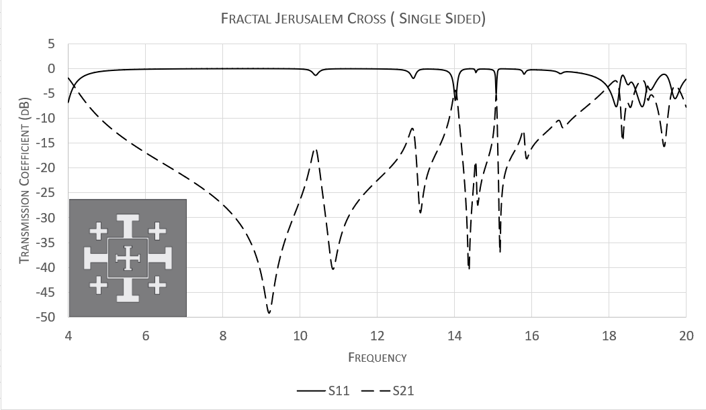
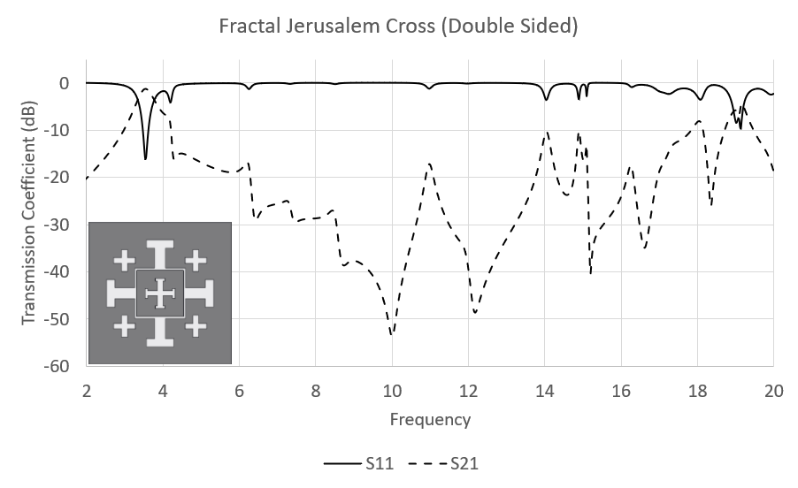
Result Analysis Contd.

Slide 13
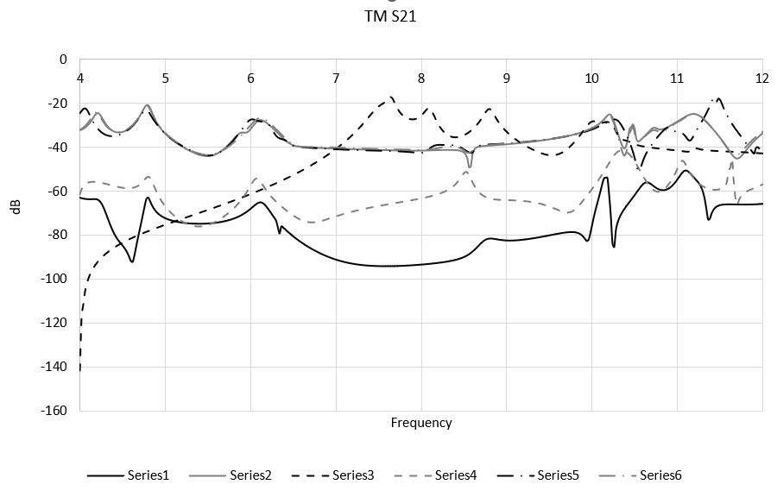
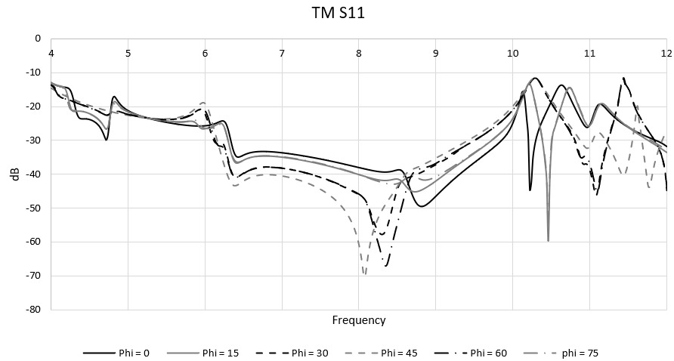
Results Analysis Contd.

Slide 14
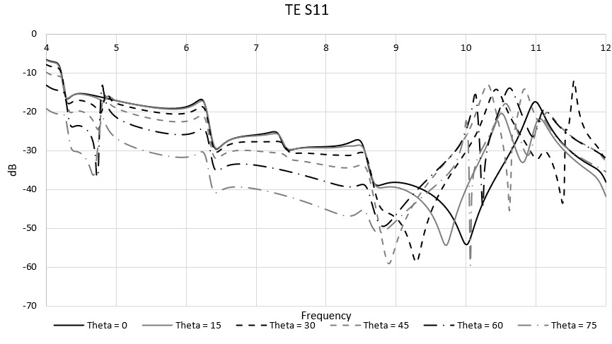
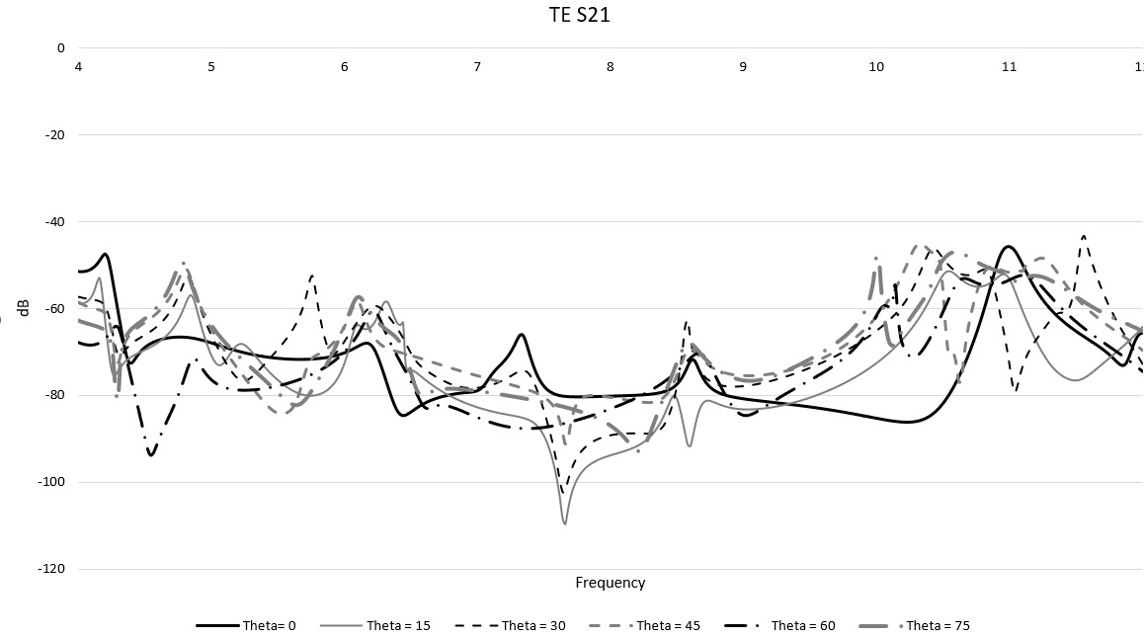
Results Analysis Contd.

Slide 15
Conclusion
Fractal Geometry Success: The fractal Jerusalem cross design significantly outperformed the standard version by offering broadband and multi-band rejection capabilities.
Robust Angular and Polarization Performance: Consistent S11 and S21 results across wide angles and both TE/TM polarizations confirm the design’s angular stability and polarization insensitivity.
Effective for Real-world Applications: The two-sided implementation enhances shielding and filtering, making the design ideal for stealth, EMI suppression, and smart sensing platforms.
Scalable and Manufacturable: Maintains a single-layer structure that balances complexity with ease of fabrication, suitable for compact and multilayer system integration.
Future Potential: The design’s scalability opens doors for use in IoT devices, next-gen wireless networks, and aerospace systems requiring lightweight, multifunctional surfaces.

Slide 16
Individual Contribution
Koustabh Ram Kandula
Literature Survey
Structure and Simulation
Anurag Sonar
Material Research
Presentation and Documentation

Slide 17
Impact on Society and Environment
Enhanced Electromagnetic Safety: By effectively filtering and shielding EM waves, the design supports safer environments in high-exposure zones like hospitals, data centers, and smart homes.
Boosts Communication Reliability: Improved signal integrity in wireless systems enhances societal connectivity, supporting better access to remote healthcare, education, and emergency services.
Supports Sustainable Tech Development: The compact, low-power-compatible design aligns with eco-friendly goals for IoT, aerospace, and next-gen communication infrastructure.
Environmentally Conscious Fabrication: The single-layer structure minimizes raw material usage, reduces manufacturing complexity, and limits environmental waste and emissions.
Enabler for Smart, Green Systems: Can be embedded into smart windows, stealth structures, or conformal wearables, contributing to energy-efficient and eco-integrated urban systems.

Slide 18
Project Outcome
Comprehensive research paper titled " Fractal Jerusalem Cross-Based FSS for Broadband X-Band Applications "
Submitted for peer review to the 2025 International Conference on AI Solutions for Sustainable Electronics and Wireless Systems (AISSEWS 2025)
Showcases innovative fractal geometry approach addressing bandwidth-angular stability trade-off
Emphasizes practical fabrication using standard PCB techniques for industrial relevance

Slide 19
References
B.A. Munk, Frequency Selective Surfaces: Theory and Design. Hoboken, NJ, USA: John Wiley & Sons, 2000.
R.J. Langley, E.A. Parker, and T. Arabadzhiyska, “Frequency selective surfaces—a review,” IEE Proceedings-Microwaves, Antennas and Propagation, vol. 145, no. 3, pp. 213-218, 1998.
W.C. Chew, “Frequency selective surfaces,” in Waves and Fields in Inhomogeneous Media, Hoboken, NJ, USA: IEEE Press, 1995, pp. 568-601. (For access, search the book title on IEEE Xplore or use WorldCat:)
E.A. Parker, P.H. El Sheikh, and R.J. Langley, “Wire-element frequency selective surfaces,” IEE Proceedings H - Microwaves, Antennas and Propagation, vol. 138, no. 3, pp. 165-170, 1991.
R. Cahill and R.J. Langley, “Cross-shaped frequency selective surfaces,” IEE Proceedings-Microwaves, Antennas and Propagation, vol. 141, no. 4, pp. 275-278, 1994.
D.H. Werner, S. Ganguly, and M.A. Khalid, “Fractal antenna engineering: the space filling Hilbert curve,” IEEE Antennas and Propagation Magazine, vol. 45, no. 5, pp. 38-49, 2003.
J.P. Gianvittorio and Y. Rahmat-Samii, “Fractal FSS: A novel dual-band frequency selective surface,” IEEE Antennas and Propagation Society International Symposium. 2002 Digest., vol. 2, pp. 756-759, 2002.
J. Romeu and A. Cardama, “Multifractal shaped frequency selective surfaces,” IEEE Antennas and Propagation Society International Symposium. 1999 Digest., vol. 3, pp. 1624-1627, 1999.
M.A. Zahid, K.P. Esselle, and C. Fumeaux, “Broadband frequency selective surfaces with multiple closely spaced transmission zeros,” IEEE Transactions on Antennas and Propagation, vol. 58, no. 12, pp. 3989-3996, 2010.
S.M.M. Abadi, R. Azadegan, and S.V. Salehi, “A novel multi-band frequency selective surface with square loop and Jerusalem cross elements,” Progress In Electromagnetics Research, vol. 141, pp. 665-678, 2013.

